Slide 1

Object Oriented Programming Android Tutorials Tutorial #3 : Move a Bitmap
Department of Computer Science and Information Engineering
Shuo-Han Chen (陳碩漢), shchen@csie.ntut.edu.tw
Hong-Yue Technology Research Building 1223
F 09:10 - 12:00
Notes:
Good Afternoon everyone
I am Shuo-Han Chen, a postdoctoral research fellow at Academia Sinica
It is a great honor to be invited by the department for being here today

Slide 2

Android Game Framework 使用說明
練習3：移動在Game 畫面中的圖形。
Notes:
Thank you for listening. Now, I would like to end today’s talk by the Q & A time.

Slide 3

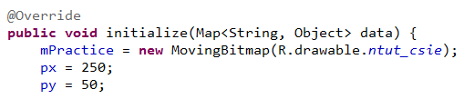
1.請先完成練習2。
2.在StateRun.java 中加入兩個位置變數：
3.在StateRun.java 中的initialize()中初始兩個變數：

Slide 4
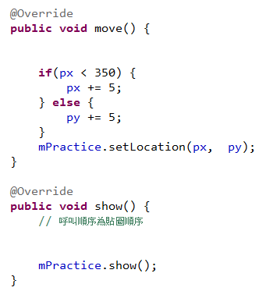
4.在move()內更改圖像的座標，而show()只負責顯示圖像所以不用變更：

Slide 5
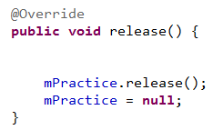
5.在每個State 結束時，釋放記憶體空間：
6.執行。

